Slide 1
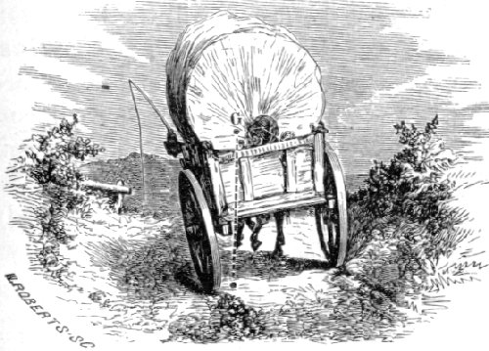

Evolution of Transportation and Roadways
By: David Bupp
Per. 1B
(Covered wagon, 2007)
Notes:
http://inventors.about.com/library/inventors/bl_history_of_transportation.htm

Slide 2
Thesis
Due to the need of connections in the emerging cities of America, faster transportation and new roadways were a necessary addition. However this idea did not truly evolve until the Jackson administration. President Jackson established a system to build new roadways, canals and railroads which connected the nation physically together.

Slide 3
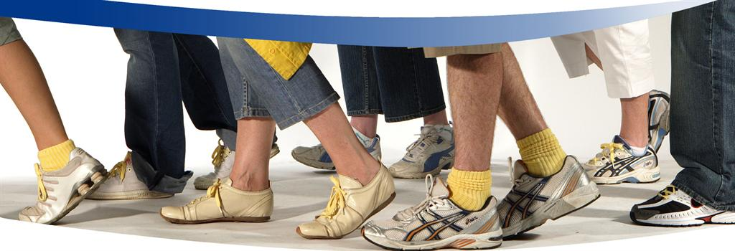
Walking still going strong (Forever-Ever)
(Walking, 2007)
Walking has been one of the oldest ways to get around since the dawn of time when people were just beginning to walk up-right. However In a historical context one can wonder what is so special to write about, well if it wasn’t for the ability to run the colony that was founded by William Penn would have never been founded on fair beliefs. William Penn, founder of Pennsylvania, found his land in a fair trade with the Native Indians where he paid 1200 pounds for as much land one man could go in one day, now if he had not picked his fastest runner he would have never gotten a large amount of land. (Dr. Sandy Crihfield lecture, 2007)
The picture shows a pace, which can be said, sets the speed of development in a world of physical and economical growth. Also the picture above can also show the connectivity that the nation holds because of the multiple people all walking in the same direction. Another thing would be the fact that with out the physical human movement nothing else would have ever been created or developed which is why it is possibly the most important evolutionary step in transportation.

Slide 4
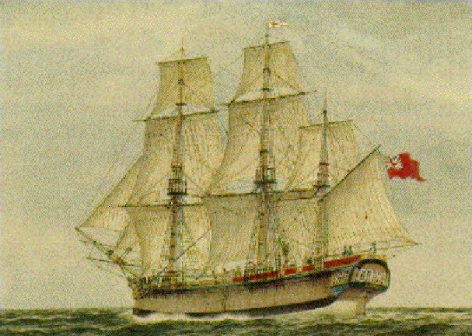
(American Colony Ships, 2007)
Setting Sail for a New Life (1600-1877)
The Ship I have shown above represents the way hundreds of thousands of people travel across the sea to experience a new life and opportunities. The reason why I have the picture is because, this is the earliest use of transportation that is used in America and evolves the least as time goes on. The ship is also a symbol of a life as it contained passengers that gave their trust to the captains to get them across the Atlantic. Ever since the beginning of the American colonies, Immigrants have flocked together in large ships to come to America. As the picture above shows, a grand ship like those was able to transport thousands of families to the new world in hopes of a better life. The ship’s journey would last several weeks with passengers often becoming ill or dying, this proved to the fullest extent during the slave trade when tight and loose packing was implemented. The only way to even speed the trip up would be setting sail at an English port because of the favorable currents compared to what even Christopher Columbus would agree with when he went against the currents and losing 2 ships as a result.(Dr. Sandy Crihfield’s Lecture, 2007)

Slide 5
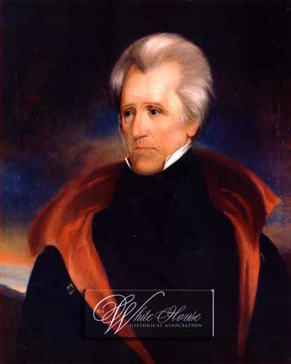
(President Andrew Jackson, 2007)
Jackson Administration sets the pace (1829-1837)
Between 1800 and 1840 the US experienced revolutionary improvements in transportation, which directly effected the individual transport and the economy.(Faragher ,Buhle, Czitrom & Armitage, 2007) Canals and railroads became popular because of their year long availability compared to the roads that may or may not be used. Now because of Jackson’s pro-west attitude he petitioned for better transportation in the country as well as more expansion towards the unknown of the west.
As shown in the picture Andrew Jackson was a strong-willed man who stood out as a war hero as well as a man of the west. This reputation he held helped him be elected for president as well as know the circumstantial problems of the west. So by the time he effectively connected the nation with railroads and canals the average travel time of a cross country trip was cut from a five week journey to a one week one. The time it took to fully connect the nation was done in a span of a few years and the job itself offered new jobs for the incoming immigrants of Ireland as well as new opportunity to move around.(Faragher, Buhle, Czitrom & Armitage, 2007)

Slide 6
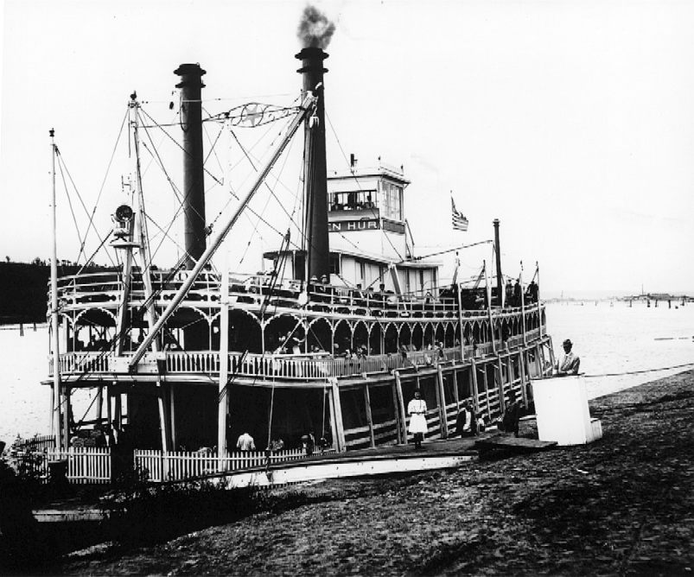
(Steamboat, 2007)
Steamboats: rides on the river (1787-1870s)
The picture above is of a steamboat which was quite popular because of its fuel source, which was perfected by James Watt in 1769, and eventually made into an engine that propelled boats through water. (Bellis, 2007) The design was not that it was a faster model, compared to the sailboat, rather it required less work to control it and thusly made it a great machine for river and lake crossing for passengers and merchandise. As the theme states the rides on the river were quite important because of the lack of strong bridge to transport people and product between rivers and such. The first steamboat was first put to use on August 22, 1787, when John Fitch made the first successful trial of a forty-five-foot steamboat on the Delaware River. (Bellis, 2007) This was an astounding feat for this time period because the steam engine only came out in 1769 and to put it to such a great use was an amazing show of power. (Bellis, 2007) This later went on to build the uses of steam power, which became used for locomotives and mining machines. The reason the picture represent the theme is because, as you can see, many customers are onboard and ready for travel and shows the popularity of the machine during this time period. (Bellis, 2007)

Slide 7
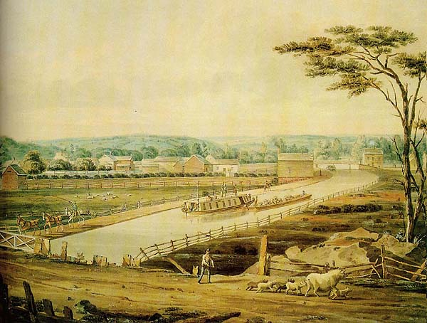
(Deusen, 2003)
Erie Canal becomes big hits for travelers and merchants (1810-1845)
The picture above shows the Erie Canal as a passable route that was done via new river routes that were hand crafted, often by Irish Immigrants, and used to connect from major ports to navigable rivers. River passages is a big part of American history because many towns and cities were established by water sources for trading purposes as well as lifestyle ones. The river travel is especially meaningful in the south as a way to get from place to place because of lack of towns, so by opening for rivers merchants can navigate the rivers towards the plantations of south and give or get merchandise for business reasons.
On Saturday October 23, 1819, the first flatboat was put onto the waters of the Erie Canal and pulled along the 30 miles in a round trip from Utica to Rome in 8 hours and 20 minutes. (Deusen, 2003) This was a great achievement towards all parties involved in the production of the canal that eventually brought thousands of passengers and by the end of 1824 the canal had already collected a third of a million dollars in tolls. (Deusen, 2003) The Canal was a way for people to travel along rivers instead of having to hike along land. The main reason I chose this theme would be because of the uses it is used as and the ingenuity that humanity as created it to do. (Deusen, `2003)

Slide 8
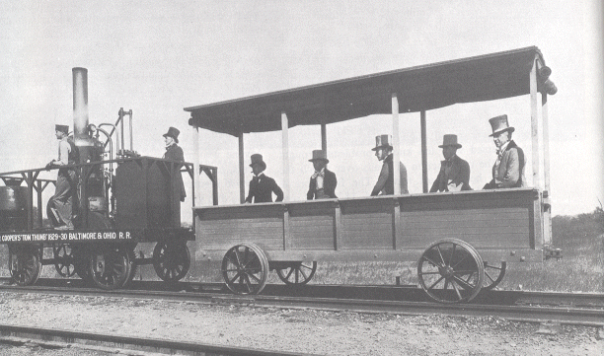
(Poole, 1999)
Tom Thumb brings new movement 1830- 1877
The picture above is of the famous Tom Thumb, which was the first regularly scheduled steam train to run, for the public, in the America at Charleston, South Carolina on December, 25 1830. (Poole, 1999) This train brought a new craze to America that brought transportation to new speeds and comfort. The trend can truly be shown in the fact that by 1860 the U.S. had over 6000 miles of railroads built, which compared to the rest of the world’s 3000 miles, shows huge favoritism to the growing system. (Dr. Sandy Crihfield’s Lecture, 2007)
The steam train was a growing industry that could easily transfer loads of passengers or heavy cargo from the production centers of the South to the manufacturing areas of the North. Tom Thumb was a leading example that showed its new speed would later overcome the canal business because of its wider options of travel and the times it made it in. The speed was not the only thing that made the railroad desirable, for the train had a year long accessibility as well as a bigger cargo handling system that could carry hundreds of pounds of products which was a must have for businesses that needed supplies immediately. However this did not come without fallbacks, for example, derailment was a problem as well as lubrication of the gears. (Poole, 1999)

Slide 9
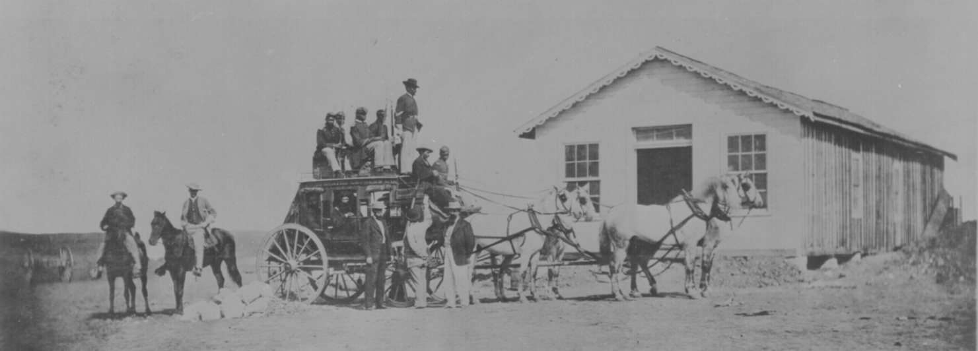
(Mail and passenger stagecoach, 2007)
Mail and Passenger stagecoach (1827-1900s)
The term "stage" originally referred to the distance between stations on a route, the coach traveling the entire route in "stages," but through constant misuse it came to apply to the coach. A stagecoach could be any four wheeled vehicle pulled by horses or mules, which was the primary requirement, being that it was used as a public conveyance, and ran on an established route and schedule. Now the one above is a picture of a Concord stagecoach that were commonly used for mail and passenger transport this, plus the armed guards, show that the reputation of the coach was so secure that it was also the choice of rich or even royalty.
The idea of the horse and buggy was something that has been evolved since then, and as a result the carriage, stagecoach and other transports were developed. The stagecoach itself grew a reputation that it was built so solidly that it became known that they didn't break down but just wore out over a long period of time. The stagecoach would also be known as the body design of future automobiles because of its design and mobility, which can be said evolved into today's culture. (Braudel, 1984)

Slide 10
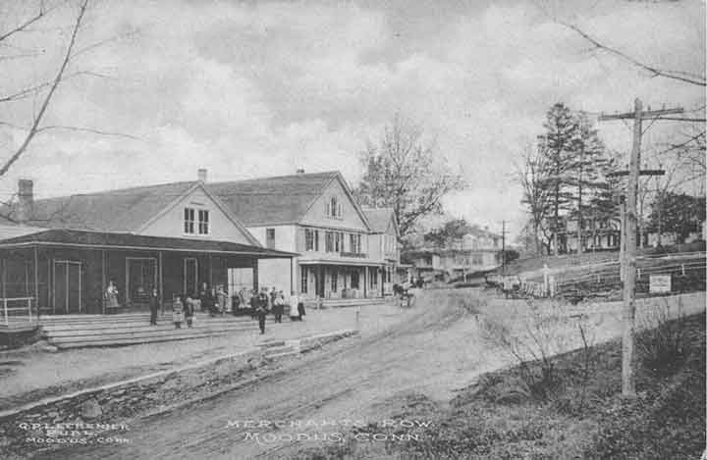
(Early roads, 2007)
Roadways Evolution (1700’s-present day)
The picture show a simple dirt road that were common in rural towns across America, it also shows a town that is pretty modern for that time with electricity lines as well as telephone poles. A recurring theme that pops up throughout history is one of adaptation with our surroundings and using it to thrive. So a road can often be much more than what it really is, for example, it can show a paved route that connects towns and keeps us strong through unity as a nation.
When the early colonies first began to expand and build towns, they connected these emerging cities with routes that the Native Indians used which were basically animal trails. This shows that the Indians took from the animals and built on it, then we do the same to them and evolve it into the paved roads of today. In the late 1700s, roads would consist of fallen trees that were placed in a line to offer a way off of the muddy ground, this was later improved by John Loudon McAdam and Thomas Telford who offered the first macadam roads, which were basically rocks placed in smooth, symmetrical patterns. (Bellis, 2006) Asphalt was the next step and the first uses of this type of material were in Battery Park and on Fifth Avenue in New York City in 1872 and on Pennsylvania Avenue, Washington D.C., in 1877. (Bellis, 2006) This offered much excitement to the rest of the nation and more orders were sent for interstate roads to be paved with this new material. (Bellis, 2006)

Slide 11
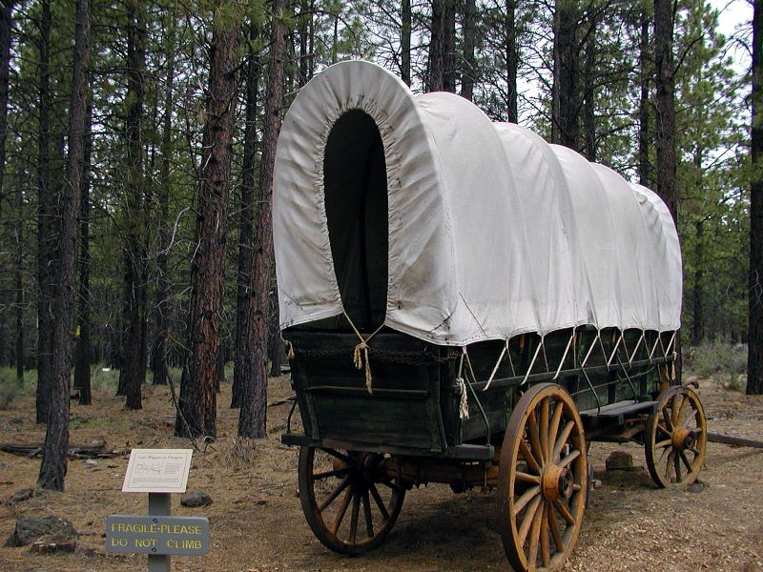
(Covered Wagon,2007)
Onward to the West (1725-1870s)
The image above is a replica of a Conestoga wagon which was rarely used in westward expansion but opened up many opportunity for travelers. The theme it represents is mainly about the uses in the travels along the Organ Trail as well the hardships it brought. The wagon was large enough to transport loads up to 8 tons, and was drawn by 4 to 6 oxen, as well as being fairly cheap for that time with a price ranging from $1.00 -$2.50. (CNETA, 2001)
The Great Migration of 1843 was a time when the populated parts of America were becoming to crowded and where hundreds of families departed towards the west in search of a better life in the west. (Dr. Sandy Crihfield Lecture, 2007) The first Conestoga wagons appeared in Pennsylvania around 1725 and were mainly used in travel between the northern and southern areas and were widely used by merchants and travelers looking for money. (CNETA, 2001) However during the 1840’s the wagons design was fitted to be of more use to the westerners who would vary in the use of types depending on size of group, equipment, and amount of personal money. (CNETA, 2001) The Wagon would later become an icon for the western expansion as a useful tool and harmful hassle because of its bulky size and weight as well as its hard to replace parts.(CNETA, 2001)

Slide 12
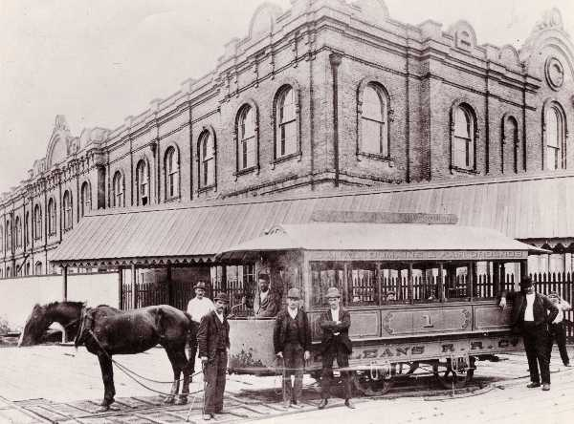
(Streetcars, 2007)
Streetcars: the Perfect Fusion (1827- 1900s)
The Theme represents the mixture of which the streetcars and cable cars bring into the era, as well as the showing off how far the transportation has come. The streetcar was developed in 1827, that acted as a bus, which could transport groups of people to work or home and by doing that becomes a helpful part of early commuter traffic. (Branley, 2005) So by having several things in a fusion of materials you can really see the outcome in multiple ways such as a cable car or other fusion type transports.
The picture above is one of John Stephenson’s streetcars that were built to travel along tracks pulled by horses or mules, this became popular in city areas because of the ability to hold nearly two dozen passengers in quick trips. (Branley, 2005) This idea was further evolved in 1871 when the perfect combination of a steam powered engine and railed tracks were combined to make the dream of San Franciscan Andrew Smith Hallidie come true, with the invention of the first cable car. (Bellis, 2006) This was a remarkable machine that Hallidie created which was basically a mechanism by which cars were drawn by an endless cable running in a slot between the rails which passed over a steam-driven shaft in the powerhouse. (Bellis, 2006)

Slide 13
References
(2007). American Colony Ships. Retrieved November 17, 2007, from Google Images Web site: http://www.google.com
Bellis, M (2006). Streetcars - Cable Cars . Retrieved November 22, 2007, from History of Transportation Web site: http://inventors.about.com/library/inventors/blstreetcars.htm
Bellis, M (2006). The History of Roads and Asphalt. Retrieved November 23, 2007, from About.com Web site: http://inventors.about.com/library/inventors/blasphalt.htm
Bellis, M (2007). The history of steamboats. Retrieved November 22, 2007, from History of Transportation Web site: http://inventors.about.com/library/inventors/blsteamship.htm
Branley, E. J. (2005, August 19). canal streetcar. Retrieved November 22, 2007, from canal streetcar (dot com) Web site: http://www.canalstreetcar.com/archives/2005/08/bobtail_streetc.html
Central Nevada Emigrant Trail Association(CNETA), (2001). The trail through Nevada. Retrieved November 21, 2007, from Trail of the 49ers Web site: http://ourworld.compuserve.com/homepages/trailofthe49ers/trail.html
(2007). Covered wagon. Retrieved November 21, 2007, from Google Images Web site: http://www.google.com
Deusen, H (2003). Erie canal. Retrieved November 21, 2007, from 18th and 19th Century New York History Web site: http://www.iment.com/maida/familytree/henry/history/eriecanal/index.ht m#open1819

Slide 14
(2007). Early roads. Retrieved November 23, 2007, from Google Images Web site: http://www.google.com
(2007). Erie Canal. Retrieved November 21, 2007, from Iment History Web site: http://www.iment.com/maida/familytree/henry/history/eriecanal/index.htm
Faragher & Buhle & Czitrom & Armitage, J, M.J., D, S.H. (2002). Out of many: A history of the american people. Upper Saddle River, New Jersey: Prentice Hall.
(2007). Mail and Passenger Stagecoach,2007. Retrieved November 23, 2007, from Google Images Web site: http://www.google.com
Poole, K (1999). Fall, 1999 Railroads topic 4 part 2 page. Retrieved November 19, 2007, from University of California, San Diego, Dr. Keith T. Poole Web site: http://www.voteview.com/rtopic4b.htm
(2007). President Andrew Jackson. Retrieved November 19, 2007, from Google Images Web site: http://www.google.com
Stagecoach. Wikipedia, The Free Encyclopedia. 9 Nov 2007, 15:46 UTC. Wikimedia Foundation, Inc. 23 Nov 2007 http://en.wikipedia.org/w/index.php?title=Stagecoach&oldid=170343853
(2007). Steam Boat. Retrieved November 22, 2007, from Google Images Web site: http://www.google.com
(2007). streetcars. Retrieved November 22, 2007, from Google Images Web site: http://www.google.com

Slide 15
(2007). Tom Thumb Railroad. Retrieved November 19, 2007, from Google Images Web site: http://www.google.com
(2007). Walking. Retrieved November 23, 2007, from Google Images Web site: http://www.google.com

Slide 16
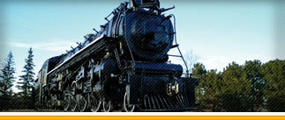
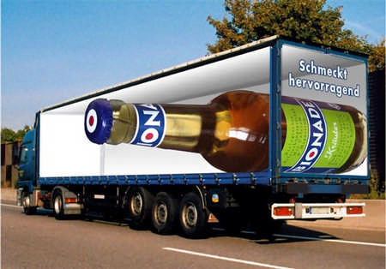
(Trains, 2008)
Evolution of
Transportation and Roadways Part 2
(trucks, 2008)

Slide 17
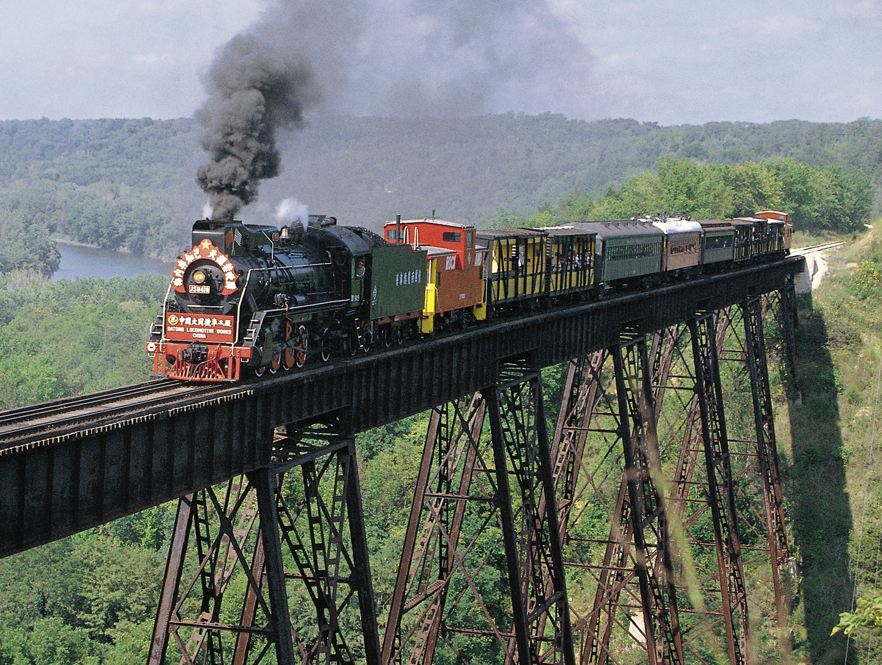
Outline
Front page
Outline
Thesis
Evolution of the road travel
The first steam Automobile
The evolution of Fuel
Gas
Electric
Biofuel
Future
Steam Locomotive
Aeronautics
Plane
Helicopter
Evolution of the information transportation
Telegraph
Telephone
Internet
Conclusion
Reference
(Train, 2008)

Slide 18
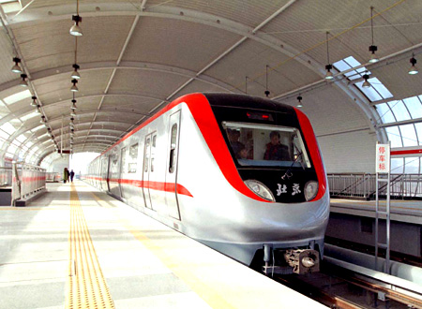
THESIS pt.2
Due to the continuous advances in technology America has grown to become a fast paced society that is ultimately connected as a country through transportation in the physical sense as well as the virtual, even though some advances in technology have hindered America, a majority has worked in favor for the American dream.
(Transportation, 2008)

Slide 19
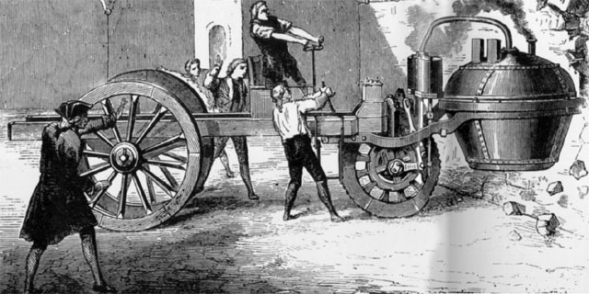
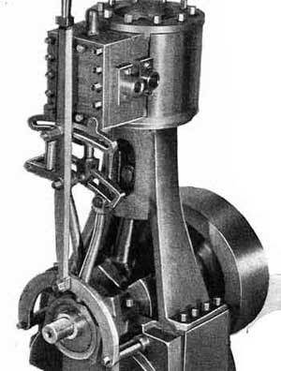
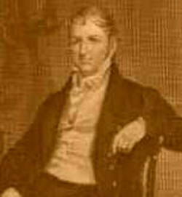
(Steam Engine, 2008)
(Steam powered vehicle, 2008)
Nicolas Joseph Cugnot (1725 - 1804) created the first steam powered vehicle which uses a steam engine to run. In 1771, Cugnot drove one of his road vehicles into a stone wall, making Cugnot the first person to get into a motor vehicle accident. However, with that accident people began to fear the machine and Cugnot’s company and invention lost the money to fund the project which stopped the growth of the industry until later years where his work contributed to the modern automobile. (Bellis, 1997)
Steam engine- (noun) powered cars by burning fuel that heated water in a boiler, creating steam that expanded and pushed pistons that turned the crankshaft, which then turned the wheels.(Bellis, 1997)
Nicolas Joseph Cugnot set the ground work for future works like the steam-powered stagecoaches, steam powered road carriage, and the steam powered cars.(Bellis, 1997)
(Nicolas Joseph Cugnot, 2008)

Slide 20
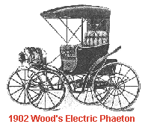
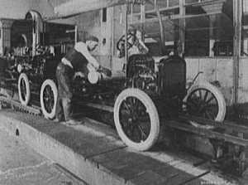
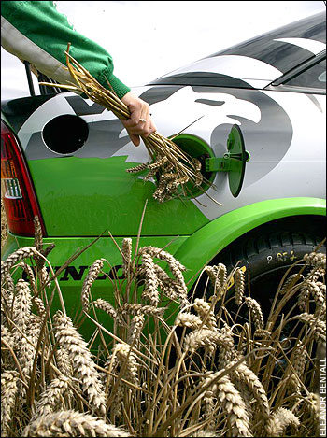
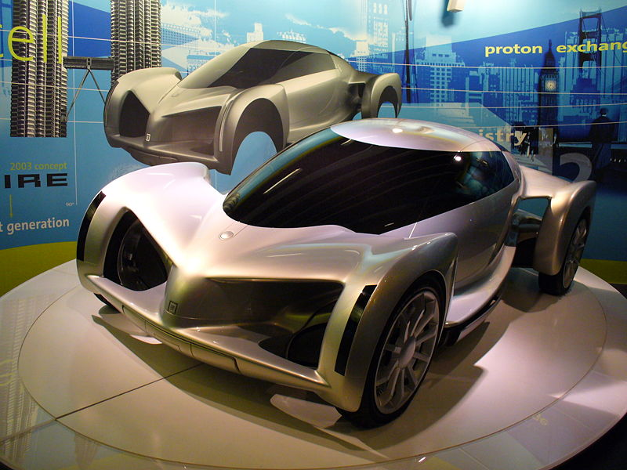
Gas
Biofuel
Electric
Future?
In 1824, Samuel Brown adapted an old Newcomen steam engine to burn gas, and he used it to briefly power a vehicle up a hill, thus making the first gas engine.
(Bellis, 1997)
Bio fuel is basically fuel produced from renewable resources, especially plant biomass, vegetable oils, and treated municipal and industrial wastes. Biofuels are considered neutral with respect to the emission of carbon dioxide because the carbon dioxide given off by burning them is balanced by the carbon dioxide absorbed by the plants that are grown to produce them.(dictionary.com, 2008)
Between 1832 and 1839, Robert Anderson of Scotland invented the first crude electric carriage.
Now that we are into the 21st century, lots of new technologies are being developed, and many scientists feel that it's time to create fuels to supplement or even replace fossil fuels. Such fuels like Hydrogen, Methanol, Electricity, Ethanol, and Natural Gases are said to be much cleaner and also renewable. The new fuels would also bring in new designs for cars to be more effiecient for the coming years. (Karim, 2008)
The concept of biofuels is surprisingly old. Rudolf Diesel, whose invention now bears his name, had envisioned vegetable oil as a fuel source for his engine. In fact, much of his early work revolved around the use of biofuel. In 1900, for example, at the World Exhibition in Paris, France, Diesel demonstrated his engine by running it on peanut oil. Similarly, Henry Ford expected his Model T to run on ethanol, a corn product. Eventually, in both Diesel's and Ford's cases, petroleum entered the picture and proved to be the most logical fuel source. This was based on supply, price and efficiency, among other things. Though it wasn't common practice, vegetable oils were also used for diesel fuel during the 1930s and 1940s. (Hess, 2008)
(electric car,2008)
Practical and more successful electric road vehicles were invented by both American Thomas Davenport and Scotsmen Robert Davidson around 1842. Both inventors were the first to use non-rechargeable electric cells. Frenchmen Gaston Plante invented a better storage battery in 1865 and his fellow countrymen Camille Faure improved the storage battery in 1881. The fall of the electric car was that by the 1920s, America had a better system of roads that now connected cities, bringing with it the need for longer-range vehicles. (Sheen, 1998)
(Model T, 2008)
In 1908 Henry Ford built the Model T which over nearly 20 years sold nearly 15,500,000 in the United States. In 1914 he set the pace for American modernization by introducing his patented assembly line that brought the original 728 minutes production time to a amazing 93 minutes.(Bellis, 1997)
(Biofuel, 2008)
(Future car, 2008)

Slide 21
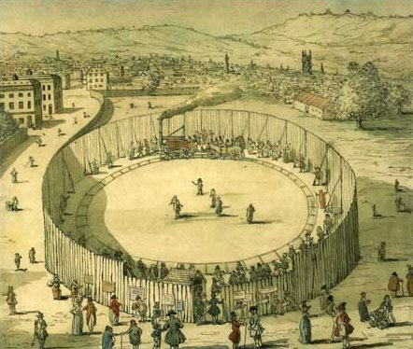
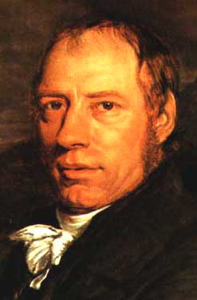
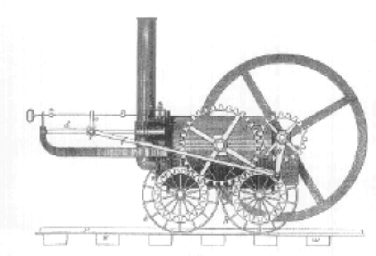
Richard Trevithick's invention is considered the first tramway locomotive, however, it was a road locomotive, designed for a road and not for a railroad, on February 22, 1804, the locomotive hauled a load of 10 tons of iron, 70 men and five extra wagons the 9 miles between the ironworks at Pen-y-Darron in the town of Merthyr Tydfil, Wales to the bottom of the valley called Abercynnon. It took about two hours. However, Trevithick's accomplishments were many and the inventor did not fully receive the credit he was due during his lifetime. For example, he is known for the Locomotive but also helped with the mining industry as well as helped with the prototype of the some of the modern boats of today. (Simkin, 1995)
(Richard Trevithick circus, 2008)
Richard Trevithick also grew famous for his circle track circus that became wildly famous attractions and made a large interest into the mechanical fields for the national populas. (Simkin, 1995)
(Richard Trevithick, 2008)
(Locomotive, 2008)

Slide 22
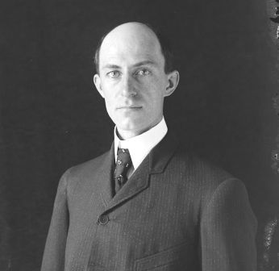
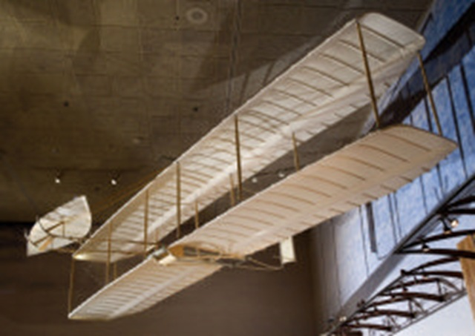
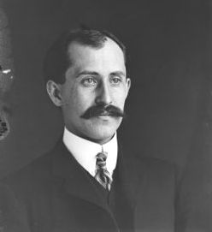
In 1901, at Kill Devil Hills, North Carolina, the Wright Brothers flew the largest glider ever flown, with a 22-foot wingspan, a weight of nearly 100 pounds and skids for landing. However, many problems occurred: the wings did not have enough lifting power; forward elevator was not effective in controlling the pitch; and the wing-warping mechanism occasionally caused the airplane to spin out of control. In their disappointment, they predicted that man will probably not fly in their lifetime. (Brooks, 2004)
1902 they continued their gliding test.
1903 Orville Wright took the Flyer for a 12-second, sustained flight.
1904 the first flight lasting more than five minutes with The Flyer II was flown by Wilbur Wright.
1909 the U.S. Government bought its first airplane.
1911 the Wrights' Vin Fiz was the first airplane to cross the United States. The flight took 84 days, stopping 70 times
1912, a Wright Brothers plane, the first airplane armed with a machine gun was flown at an airport in College Park, Maryland. (airports were created in 1909)
1914 an Aviation Section of the Signal Corps was established (Bellis, 1997)
(Wright Glider, 2008)
(Wilbur Wright, 2008)
(Orville Wright, 2008)

Slide 23
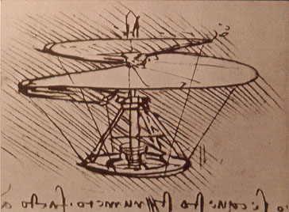
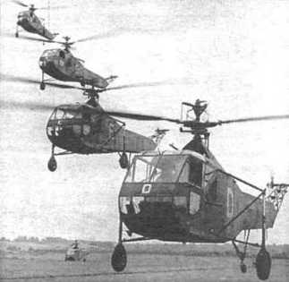
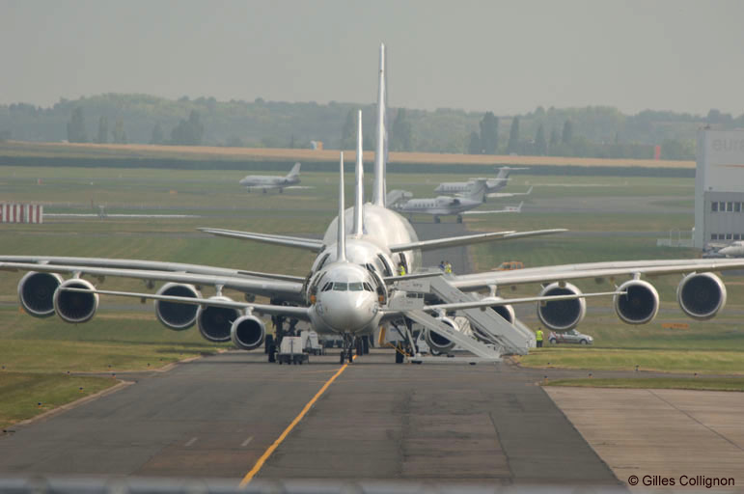
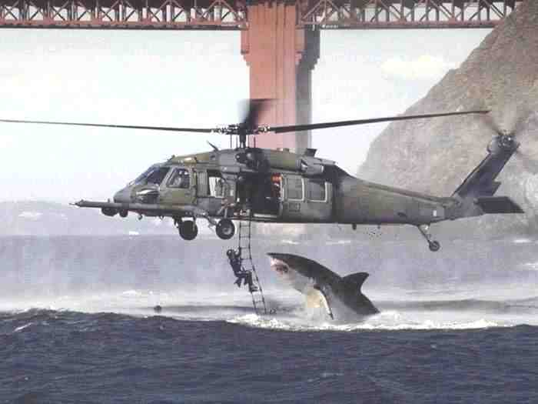
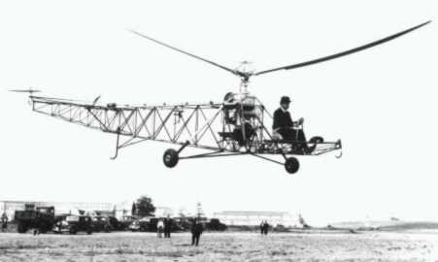
(Early helicopter, 2008)
Helicopter
(Army Helicopter,2008)
(Transportation invention, 2008)
The Helicopter was first imagined by, Italian inventor Leonardo Da Vinci who made made drawings of an ornithopter flying machine that some experts say inspired the modern day helicopter. In 1784, French inventor, Launoy and Bienvenue created a toy with a rotary-wing that could lift and fly and proved the principle of helicopter flight. (Lee, 2007)
A helicopter is any of a class of heavier-than-air craft that are lifted and sustained in the air horizontally by rotating wings or blades turning on vertical axes through power supplied by an engine.
Igor Sikorsky is credited with building the world's first helicopter in 1909 as well as being considered to be the "father" of helicopters. He is called that because he invented the first successful helicopter, upon which further designs were based.(bottom right is the machine he created). (Smith, 1999)
In 1944, American inventor Stanley Hiller, Jr. made the first helicopter with all metal rotorblades that were very stiff. They allowed helicopter to fly at speeds much faster than before. In 1949, Stanley Hiller piloted the first helicopter flight across the United States, flying a helicopter that he invented called the Hiller 360. (Lee, 2007)
Both the plane and the helicopter have worked to help with the design of today’s aeronautic design. Such as the Jumbo Jet, Stealth fighters, Cargo plane, Rescue helicopter… All of these are a part of today’s society in means of rescue, war, and invention.
(Helicopter, 2008)
(Helicopter history, 2008)

Slide 24
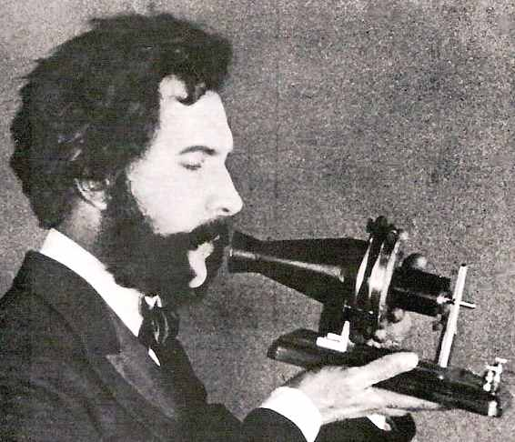
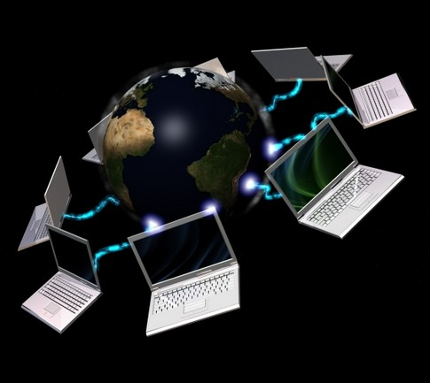
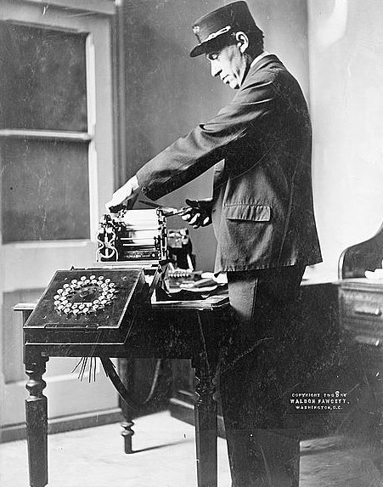
Telegraph
Telephone
Internet
Created by Harrison Dyar in 1828, who sent electrical sparks through chemically treated paper tape to burn dots and dashes that was later called in to Morse code by Samuel Morse. The dots and dashes were used to form letters that could be used to communicate around the world. (Bellis, 1997)
(Graham Bell, 2008)
In the 1969, the U.S. government created ARPANET, connecting four western universities and allowing researchers to use the mainframes of any of the networked institutions.
Successfully created by Alexander Graham Bell on March 10, 1876 where the first words transmitted were "Watson, come here; I want you.“ From Graham to his assistant Watson. Back then the telephone was owned by only the rich and still not as popular as todays culture in where we can communicate much easier than back then. (Bellis, 1997)
(Internet, 2008)
Now, new developments come to the Net one right after the other. It is this explosive growth in recent years that has captured the imagination of computer users the world over. (Carstarphen, 2006)
(Telegraph, 2008)

Slide 25
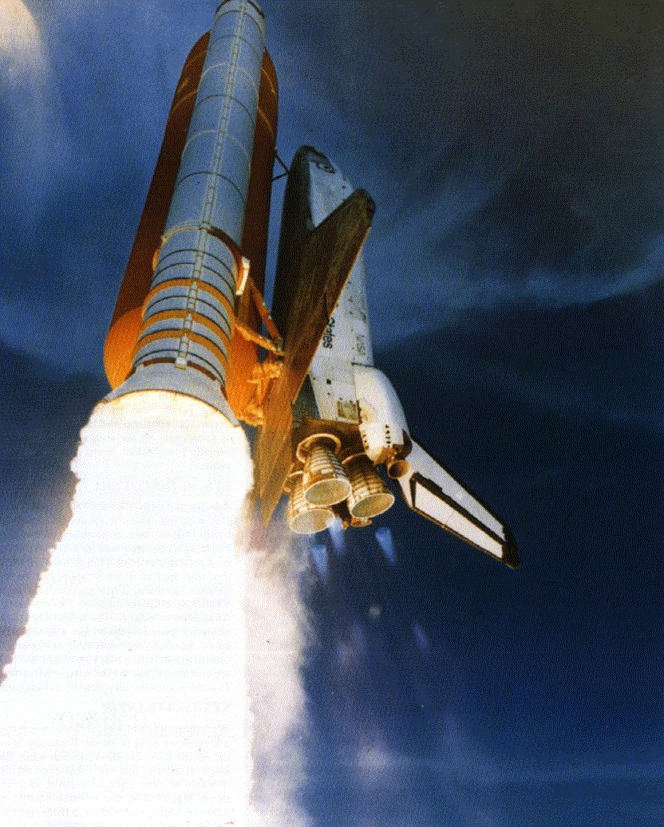
Conclusion
So in conclusion, due to the continuous advances in technology America has grown to become a fast paced society that is ultimately connected as a country through transportation in the physical sense as well as the virtual, even though some advances in technology have hindered America, a majority has worked in favor for the American dream.
(Shuttle, 2008)

Slide 26
References
(2008). Alexander Graham Bell. Retrieved May 24, 2008, from Google Images Web site: http://www.google.com
(2008). Army Helicopter. Retrieved May 25, 2008, from Google Images Web site: http://www.google.com
Bellis, M (1997). The History of Telegraph. Retrieved May 24, 2008, from About.com Web site: http://inventors.about.com/od/tstartinventions/a/telegraph.htm
Bellis, M (1997). The History of the Automobile. Retrieved May 22, 2008, from About.com Web site: http://inventors.about.com/library/weekly/aacarssteama.htm
Bellis, M (1997). The Telephone. Retrieved May 24, 2008, from About.com Web site: http://inventors.about.com/od/bstartinventors/a/telephone.htm
Bellis, M (1997). The Wright Brothers. Retrieved May 24, 2008, from About.com Web site: http://inventors.about.com/library/inventors/bl_wright_brothers.htm
(2008). Biofuel. Retrieved May 25, 2008, from Google Images Website: http://www.google.com
Brooks, J (2004). Wright Brother's History. Retrieved May 24, 2008, from centennial of flight Web site: http://www.centennialofflight.gov/wbh/index.htm
Carstarphen, L (2006). History of Internet. Retrieved May 24, 2008, from Yahoo.com Web site: http://smithsonian.yahoo.com/birthoftheinternet.html
(2008). Early Helicopter. Retrieved May 25, 2008, from Google Images Web site: http://www.google.com
(2008). Electric Car. Retrieved May 25, 2008, from Google Images Website: http://www.google.com

Slide 27
(2008). Helicopter History. Retrieved May 25, 2008, from Google Images Web site: http://www.google.com
(2008). Helicopter. Retrieved May 25, 2008, from Google Images Web site: http://www.google.com
Hess, S.M. (2008). Biofuel History. Retrieved May 25, 2008, from How Stuff works Web site: http://auto.howstuffworks.com/biodiesel2.htm
(2008). Internet. Retrieved May 24, 2008, from Google Images Web site: http://www.google.com
Karim, N (2008). Fuels of the Future. Retrieved May 25, 2008, from Think Quest Web site: http://library.thinkquest.org/04oct/00927/index.htm
Lee, T (2007). history of helicopters. Retrieved May 25, 2008, from Rotaryaction.com Web site: http://www.rotaryaction.com/history.html
(2008). Model T. Retrieved May 25, 2008, from Google Images Website: http://www.google.com
(2008). Nicolas Joseph Cugnot. Retrieved May 22, 2008, from Google Images Web site: http://www.google.com
(2008). Orville Wright. Retrieved May 24, 2008, from Google Images Web site: http://www.google.com
(2008). Richard Trevithick. Retrieved May 22, 2008, from Google Images Web site: http://www.google.com
(2008). Richard Trevithick circus. Retrieved May 25, 2008, from Google Images Web site: http://www.google.com
Sheen, L (1997). The History of the electric Automobile. Retrieved May 25, 2008, from About.com Web site: http://inventors.about.com/library/weekly/aacarselectrica.htm
(2008). Shuttle. Retrieved May 25, 2008, from Google Images Web site: http://www.google.com

Slide 28
Simkin, J (1995). Richard Trevithick. Retrieved May 24, 2008, from Spartacus Web site: http://www.spartacus.schoolnet.co.uk/RAtrevithick.htm
Smith, K (1999). The History of the Helicopter. Retrieved May 25, 2008, from About.com Web site: http://inventors.about.com/od/hstartinventions/a/helicopter.htm
(2008). Steam Engine. Retrieved May 22, 2008, from Google Images Web site: http://www.google.com
(2008). Steam Locomotive. Retrieved May 22, 2008, from Google Images Web site: http://www.google.com
(2008). Steam Powered Vehicle. Retrieved May 22, 2008, from Google Images Web site: http://www.google.com
(2008). Telegraph. Retrieved May 24, 2008, from Google Images Web site: http://www.google.com
(2008). Trains. Retrieved May 22, 2008, from Google Images Web site: http://www.google.com
(2008). Transportation. Retrieved May 25, 2008, from Google Images Web site: http://www.google.com
(2008). Transportation invention. Retrieved May 25, 2008, from Google Images Web site: http://www.google.com
(2008). Trucks. Retrieved May 22, 2008, from Google Images Web site: http://www.google.com
(2008). Wilber Wright. Retrieved May 24, 2008, from Google Images Web site: http://www.google.com
(2008). Wright Glider. Retrieved May 24, 2008, from Google Images Web site: http://www.google.com

